Slide 1
FIRE ALARM CIRCUIT

Slide 2
Submitted By:
2022456 Muhammad Younas
Supervised By
Sir Irfan Ullah
Lecturer
Ghulam Ishaq Khan Institute of Information Technology University, Topi

Slide 3
OBJECTIVES
TO SIMPLY DETECT THE FIRE AND TO ACTIVATE THE SIREN SOUND OR BUZZER.
THE PRIMARY PURPOSE OF A FIRE ALARM SYSTEM IS TO PROVIDE AN EARLY WARNING OF FIRE SO THAT NECESSARY ACTION MAY BE TAKEN.

Slide 4
COMPONENT LIST
10K THERMISTOR
LM358 OPERATIONAL AMPLIFIER
4.7K RESISTOR
10K POTENTIOMETER
5V BUZZER
CONNECTING WIRES
BREADBOARD
5V POWER SUPPLY

Slide 5
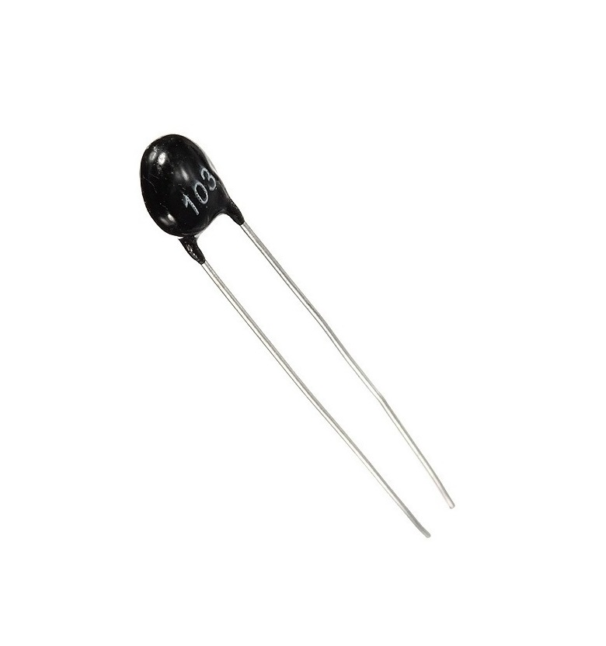
10K THERMISTOR
“Thermistors are Temperature Dependent Resistors”.
The main component in detecting the fire is the 10 K Thermistor.
The 10 K Thermistor used here is a NTC (negative temp coefficient) type thermistor, if the temperature increases, the resistance of the thermistor decreases.
In case of fire, the temperature increases. This increase in temperature will reduce the resistance of the 10 K Thermistor.

Slide 6

LM358 OPERATIONAL AMPLIFIER
LM358 is a Dual Operational Amplifier (Op – Amp) IC.
All the functional modes of the typical operational amplifier can be implemented using LM358 IC.
In this project the LM358 Operational Amplifier is used in the Comparator mode.
Here, the input signals on inverting and non – inverting terminals are compared and corresponding output is produced.

Slide 7
PONTENTIOMETER
BUZZER
The temperature at which the circuit detects fire can be adjusted by using the potentiometer arrangement.
When the temperature increases above the set value, the potentiometer arrangement produces a high voltage.
The main function of this is to convert the signal from audio to sound.

Slide 8
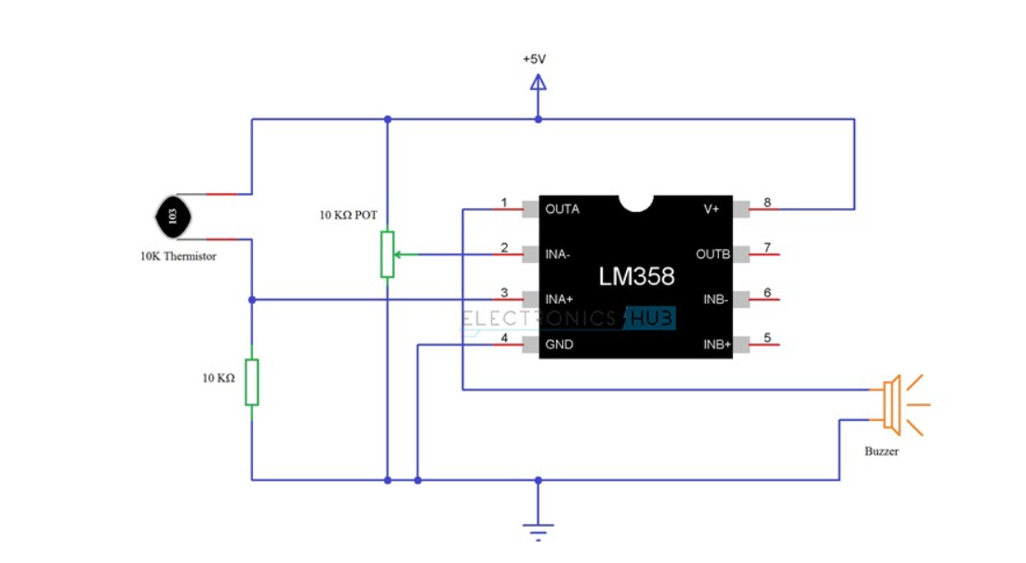

Slide 9
CONSTRUCTIONS
Firstly the 10 KΩ Potentiometer is connected to the inverting terminal of the LM358 Op – Amp.
One end of the POT is connected to +5V, other end is connected to GND and the wiper terminal is connected to Pin 2 of Op – Amp.
The output of potential divider is connected to the non – inverting input of the LM358 Operational Amplifier.
Output of the LM358 Op – amp is connected to the 5V Buzzer directly.
Pins 8 and 4 of the IC are connected to +5V and GND respectively.

Slide 10
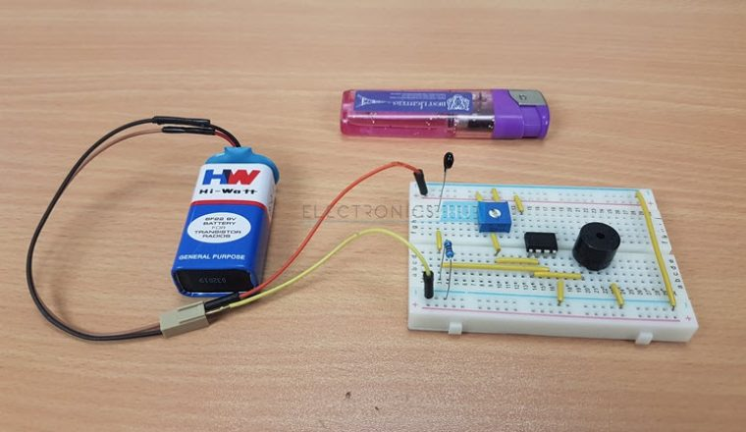

Slide 11
WORKING PRINCIPLE
In this fire alarm circuit project, a thermistor works as the heat sensor.
When temperature increases, its resistance decreases, and vice versa.
In case of fire, the temperature increases.
This increase in temperature will reduce the resistance of the 10 K Thermistor and the output of the voltage divider increases.
Output of the voltage divider is given on the non inverting terminal of the LM358IC.
Output will become more than inverting input.
As a result, the output of the op-amp becomes high and it activates the buzzer for alarm.

Slide 12
CONCLUSION
Smoke detectors are devices created and designed to alarm by voice signals when Lighting energy reduce safe levels.
They are supposed to alert people if there is a danger of fire.
Fire Alarm Circuits are very important devices to detect fire at the right time and prevent any damage to people or property.

Slide 13
THE END

